Slide 1


Singapore Community Help Social Network
Graduate Certificate in Intelligent Reasoning Systems
Project PROPOSAL presentation
SIVA KRISHNA THOTA

Slide 2
About The Project
Community help is a social network website based on Singapore to connect group of people and share useful information like other social network people can post tweets, likes and share text, images & videos through this website. Unlike other social networks, there is special feature which focus more on community interaction to help people and news sharing.
Features :
User is allowed to find near by shops/food courts in and around the community and can also explore on more offers.
Allow users to find friends in near by communities.
Merchants will receive the notifications if a user request for particular item from near by communities
Seller/Buyer can post and get the news or offers from near by community.
Based on history and interest user will get notifications on mobile app by tracking user location.
Similar like whatsup groups can be created in this application.

Slide 3
Business problem statement
Problem statement # 1
A specific popular form of online harassment is the use of abusive language. One abusive or toxic statement is being sent every 30 seconds across the globe. The use of abusive language on social media contributes to mental or emotional stress, with one in ten people developing such issues .These abusive Tweets and comments detection and deletion in social media is more important.
Problem statement # 2
Because human brains reply quickly to pictures and color in contrast to other types of information, an image is an almost invincible draw on social media. Of course, to get the concentration you want, you must share images that matter to your target audience. Although this may lead to mass data abuse images need to be detection and deletion in social media is more evitable.

Slide 4
Technical Problem Statement
Offensive Text and Image is pervasive in social media. Individuals frequently take advantage of the perceived anonymity of computer-mediated communication, using this to engage in behavior that many of them would not consider in real life. Online communities, social media platforms, and technology companies have been investing heavily in ways to cope with offensive language in the form of text or images to prevent abusive behavior in social media.
Problem statement # 1 Binary Category Classification The goal of this project is to improve abusive language detection with a focus on implicit abuse, to develop model using NLP techniques to accurately detect Abusive & and Non-Abusive language. Non-Abusive Language Abusive Text Language | Problem statement # 2 Image Classification This goal of the business use case derives to develop a model that uses Computer Vision techniques to accurately detect Abusive & and Non-Abusive Images. Safe Image Sexy Image Nude Image

Slide 5
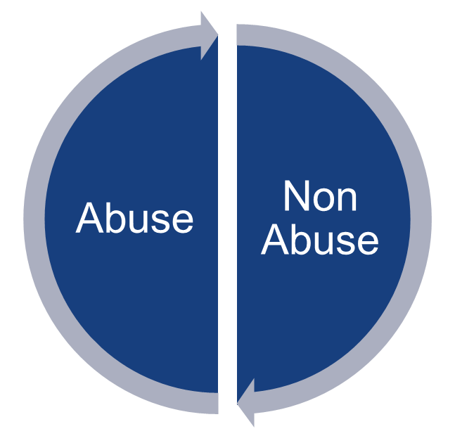
Dataset - Binary Category Classification
Process the train data carefully as the data has emojis, English texts, some symbols, links etc. Also, note that the language detected often is not correct so don't rely blindly on it.
Features like detected language of the text, total likes, total reports and views along with text are also provided. These features were not included by me during the training process.
Cleaned the data(remove emojis, punctuations etc.)
Trim the data acc to text lengths.
Below is the data set count from internet
Category | Count
Abuse | 48602
Non Abuse | 363235
Class imbalance is a common problem in machine learning that occurs when the distribution of examples within a dataset is skewed or biased. This can lead to a bias in the trained model, which can negatively impact its performance

Slide 6
About Dataset - Image Classification
we need work to prevent the spread of illegal child sexual abuse material (referred to as CSAM). Child safety organizations and governments rightly expect — and in many cases require — us to take action to remove it from our systems. Which is why, when we find CSAM on our platforms, we remove it, report it and often take the step to suspend the account.
Safe
Sexy
Nude
Category | Count
Safe Image | 38411
Sexy Image | 38005
Nude Image | 38000
Above is the data set count from internet

Slide 7

Application Flow Phase #1
Step #1
Step #2
Image
Message
NO
Step #8
Image Abuse
Detection
Step #4
Step #5
Step #7
Yes
Text Classification
Send Message
Rule Based
Engine
Step #3
Reply Back
To Sender
Text Abuse
Detection
Step #6
Emotion Detection
NO
Text Message
PYTHON
Practical Language
Processing
Intelligent Reasoning
Systems

Slide 8
Application Flowchart Phase #1
Post Message
Binary Category Classification / Binary Image Classification
Abusive
Non-Abusive
Rule Based Engine
Receive Message

Slide 9
Binary Category Classification approach
Data
Preprocess the data
Data Cleaning
EDA
Binary Class
Create word embeddings
Word2Vec
Glove
Train the model
LSTM
Bi-LSTM
CNN
Test and Predict

Slide 10
Image Classification approach
Images Data
Preprocess the data
Data Cleaning
EDA
Binary Class
Extract Features
Sift
LBP
Histogram
Train the model
CNN
VGG
ResNet
Test and Predict

Slide 11
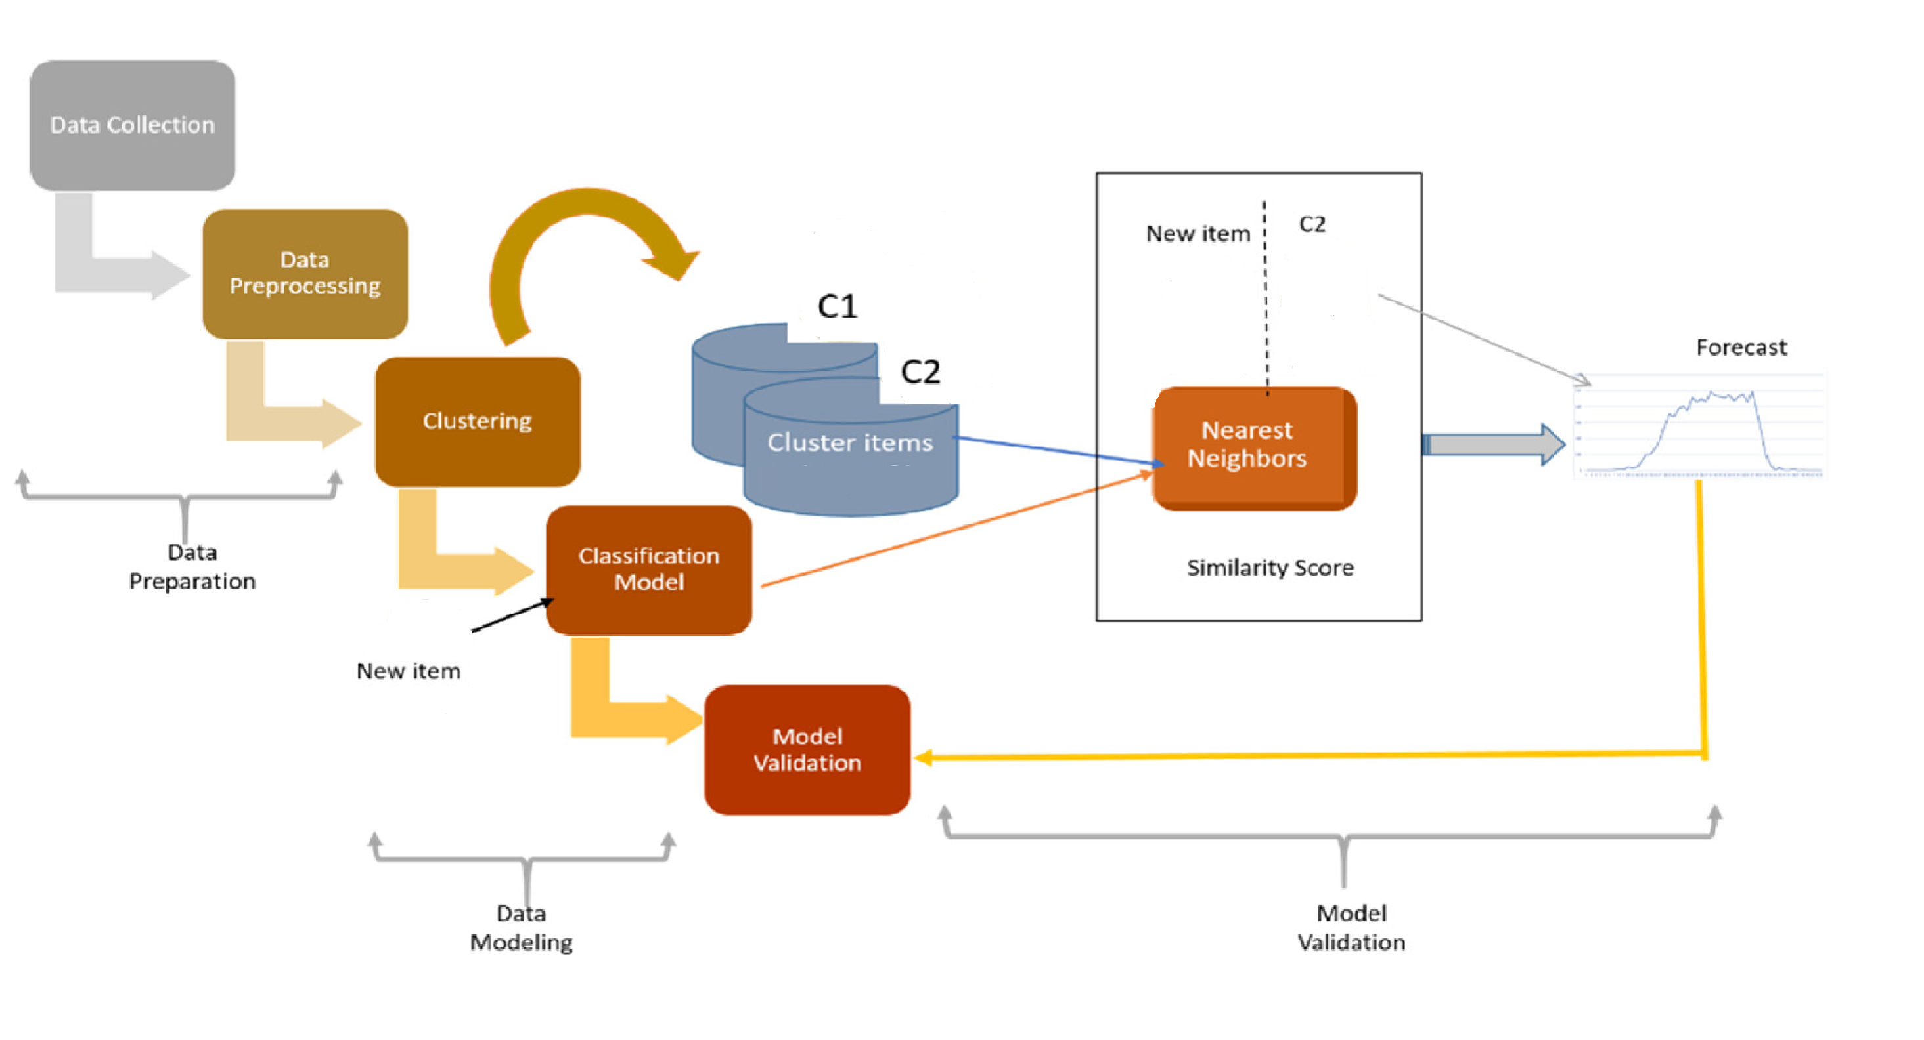
Experimental design

Slide 12
Requirements Overview
Resource Requirements
Python
NumPy
Pandas
Matplotlib
Tensor Flow
Sklearn
Jupyter Notebook
Google Colab
GPU
NLP Techniques
Computer Vision Techniques
Spyder
Django Frame Work

Slide 13
Project deliverables With Effort Estimates
Web Site built with Python using the Django Web Framework, trivial templates with Bootstrap & jQuery for UI & UX, a RESTful API for the web client using Django Rest Framework.
Design database object using SQLite
Deep learning model for Abusive language detection
Deep learning model Abusive Images detection
Task | # Days
Design Web Project / DB Design | 30 Days
Data Collection | 10 Days
For Abusive language detection | 10 Days
Abusive Images detection | 10 Days

Slide 14
References
https://medium.com/@sam.bell_43711/distracted-driver-detection-using-deep-learning-ecc7216ae8d0
https://github.com/Garima13a/YOLO-Object-Detection/blob/master/YOLO.ipynb
https://colab.research.google.com/github/d2l-ai/d2l-en-colab/blob/master/chapter_deep-learning-computation/use-gpu.ipynb#scrollTo=mwrEJrSCo-OR
https://github.com/opencv/opencv
https://github.com/prostasia/rocketchatcsam
https://github.com/kevintonb/child-abuse-image-classifier
https://github.com/swkarlekar/safecity/tree/master
https://github.com/bhaveshnaidu999/sexual-harassment-classification-project/tree/main

